Slide 1


CITS1003 Introduction to Cybersecurity [5] Vulnerabilities and Controls exercises
Dr Zhi Zhang

Slide 2
DVWA (Damn Vulnerable Web Application)
Popular Web Attacks
SQLi (SQL injection)
Command Injection
XSS (Cross Site Scripting)

Slide 3
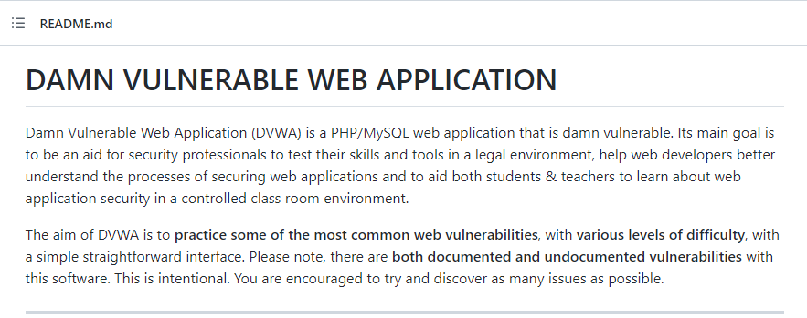
DVWA
https://github.com/digininja/DVWA

Slide 4
Deploying DVWA
Docker image is available:
https://hub.docker.com/r/vulnerables/web-dvwa
Run this image in your VM:
docker run --rm -it -p 80:80 vulnerables/web-dvwa
Open a browser
Enter a URL: localhost/setup.php

Slide 5
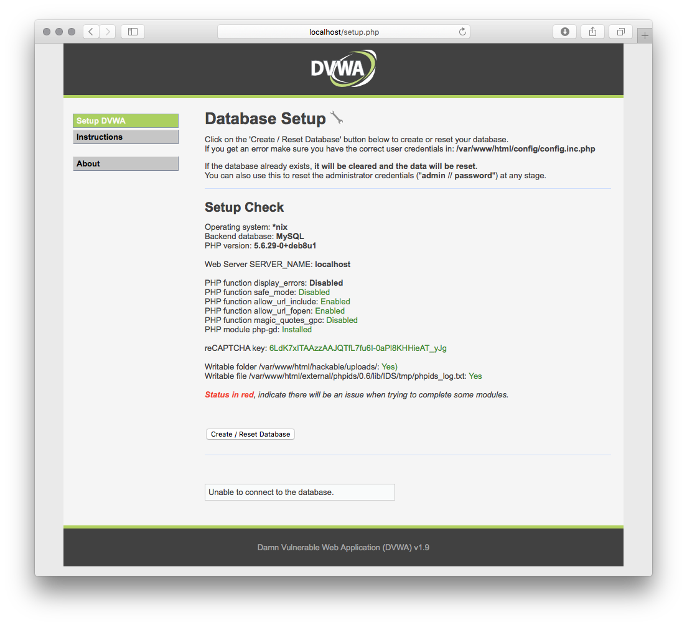

Slide 6
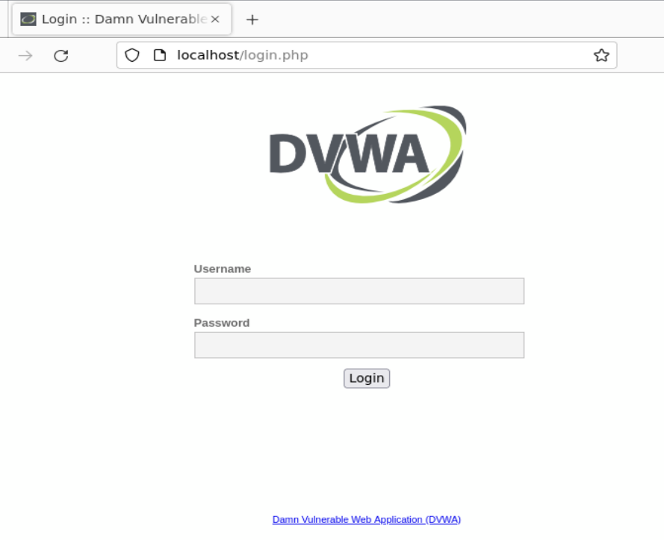
Login with default credentials.
Username: admin; Password: password

Slide 7
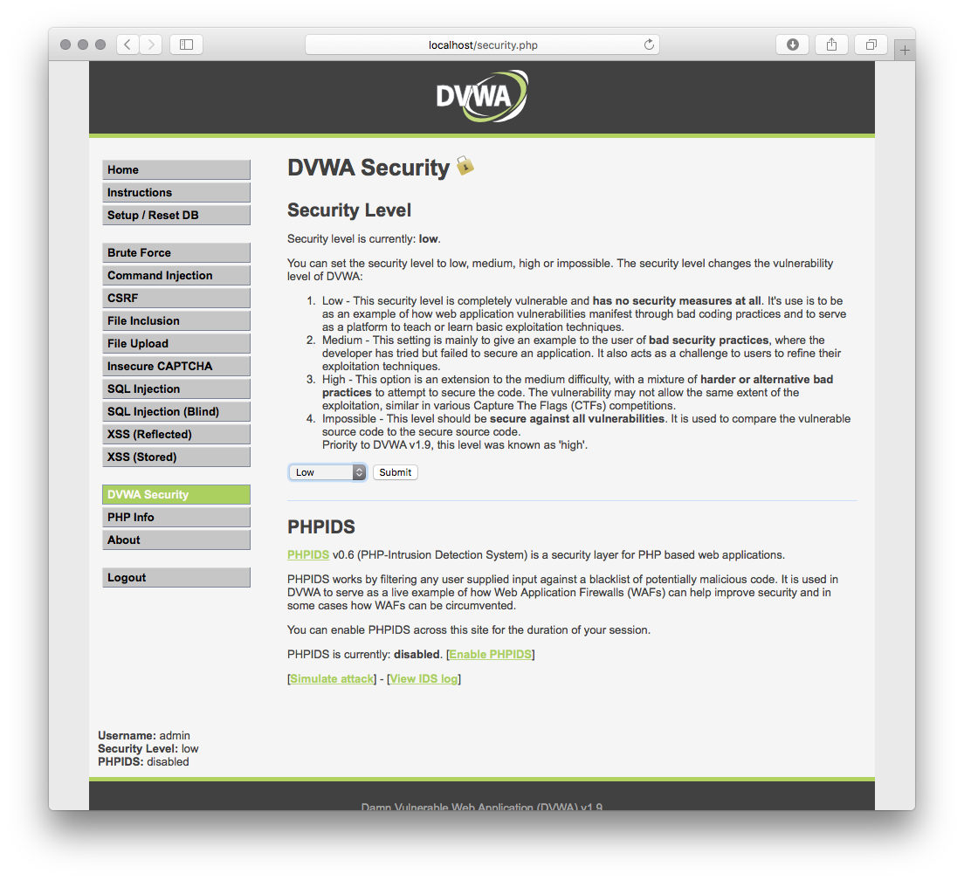
Set the security level to low

Slide 8
SQLi
What is SQLi?
SQL is Structured Query Language used to manage relational databases.
SQLi is an attack that targets security vulnerabilities in web applications that use SQL-based databases. SQLi allows an attacker to inject malicious SQL code into a vulnerable web application, which can break the CIA triad.

Slide 9
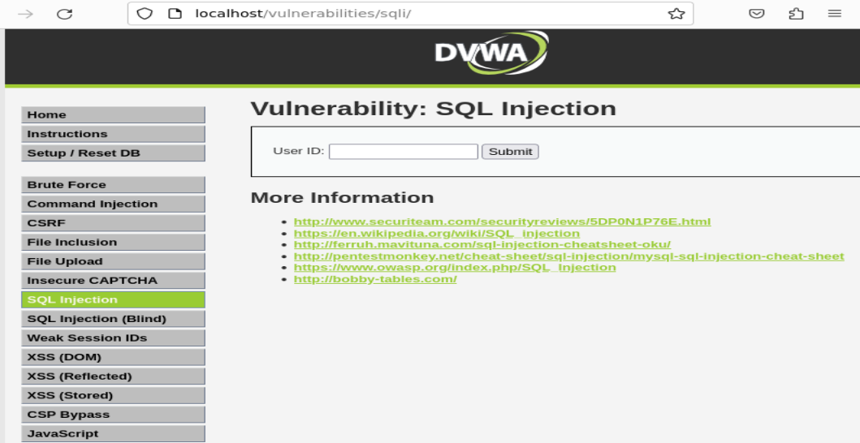
SQLi
Demo

Slide 10
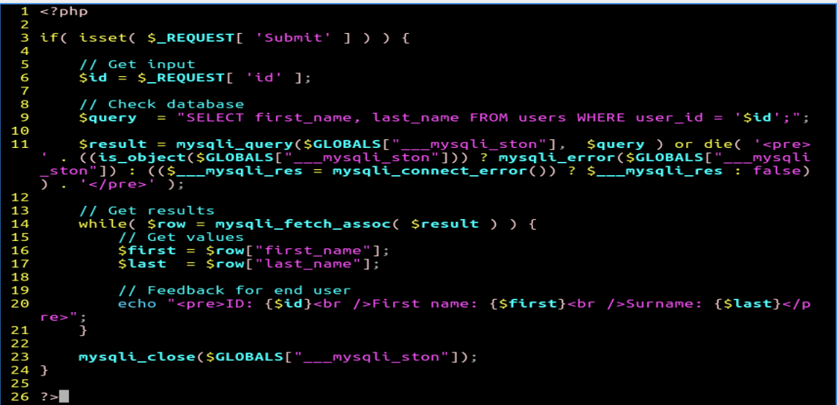
SQLi
How does SQLi occur?

Slide 11
SQLi
Line 3
First, it is an if statement:
1. if (condition) {
2. Code to be executed if condition is true.
3. }

Slide 12
SQLi
Line 3
First, it is an if statement:
1. if (condition) {
2. Code to be executed if condition is true.
3. }
e.g.,
1. $test = "30";
2. if ($test > "29") {
3. echo "hello world";
4. }

Slide 13
SQLi
Line 3
First, it is an if statement:
1. if (condition) {
2. Code to be executed if condition is true.
3. }
condition: isset():

Slide 14
SQLi
Line 3
isset($var): a function that checks whether the value of $var exists. If yes, it returns true, or false otherwise.
What is a function? A block of code that implements a specific task.
e.g., function name($fname) { echo "$fname says: hello world"; } name(“Alice");

Slide 15
SQLi
Line 3
If isset returns true, then the condition for the if statement is true:
$_REQUEST: a pre-defined variable storing values of multiple keys, such as ‘Submit’.
e.g., Given $names = [‘Alice’ => 0, ‘Bob’ => 50, ‘Eavesdropper’ => 100];
$names[‘Alice’]?

Slide 16
SQLi
Line 3
$_REQUEST[ ‘Submit’ ] is the value of the ‘Submit’ key.
What is the value of the ‘Submit’ key?

Slide 17
SQLi
$_REQUEST[ ‘Submit’ ] returns the input after clicking ‘Submit’

Slide 18
SQLi
$_REQUEST[ ‘Submit’ ] returns the input after clicking ‘Submit’

Slide 19
SQLi
$_REQUEST[ ‘Submit’ ] returns the input value after clicking ‘Submit’
isset($_REQUEST[ ‘Submit’ ]) returns true if $_REQUEST[ ‘Submit’ ] is non-empty
If (isset($_REQUEST[ ‘Submit’ ]) ) returns true if isset() returns true

Slide 20
SQLi
Line 6
$id: a variable
$_REQUEST[ ‘id’ ] returns the value of the ‘id’ key, which is the input from the ‘USER ID’
What does $id equal to? The value from $_REQUEST[ ‘id’ ]
e.g., if the input field is: 1, then $id equals to 1
if the input field is: 2, then $id equals to 2

Slide 21
SQLi
Line 9 is vulnerable
$query: a variable
SQL Statement: SELECT first_name, last_name FROM users WHERE user_id equals to ‘$id’;
SELECT, FROM and WHERE are SQL keywords:

Slide 22
SQLi
Line 9 is vulnerable
A ‘users’ table
e.g., SELECT first_name, last_name FROM users WHERE user_id = ‘1’;

Slide 23
SQLi
Line 9 is vulnerable
A ‘users’ table
e.g., SELECT first_name, last_name FROM users WHERE user_id = ‘1’;
first_name | last_name | user_id
‘Alice’ | ‘Admin’ | ‘1’
‘Bob’ | ‘Admin’ | ‘2’

Slide 24
SQLi
Line 9 is vulnerable
When $id equals to 1' or '1’=‘1
‘$id’ = ‘ 1’ or ‘1’=‘1 ’
user_id = ‘1’ or ‘1’=‘1’

Slide 25
SQLi
Line 9 is vulnerable
The SELECT statement:
returns first name and second name where user id equals to 1
returns all other users’ first name and second name from the "users" table.

Slide 26
SQLi
Line 9 is vulnerable
Root cause of SQLi: ‘$id’ is an input and it is not sanitized before it is used for this SELECT-based SQL statement.

Slide 27
SQLi
How does SQLi occur?
How dangerous is this vulnerability?
How to mitigate SQLi?

Slide 28
SQLi
How does SQLi occur?
A malicious user injects some malicious SQL code into a web application.
The application implements a vulnerable logic that uses the code to interact with an SQL database.

Slide 29
SQLi
How does SQLi occur?

Slide 30
SQLi
How does SQLi occur?
How dangerous is SQLi?
e.g., data theft; unauthorized access (data modification).

Slide 31
SQLi
How does SQLi occur?
How dangerous is SQLi?
e.g., data theft; unauthorized access (data modification).
How to mitigate SQLi?
e.g., input sanitisation; SQL DB encryption
user_id = ‘1’ or ‘1’=‘1’

Slide 32
SQLi
How does SQLi occur?
How dangerous is SQLi?
e.g., data theft; unauthorized access (data modification).
How to mitigate SQLi?
e.g., input sanitisation; SQL DB encryption
user_id = ‘1’ or ‘1’=‘1’
first_name | last_name | user_id
XXX | YYY | ZZZ
XXXX | YYYY | ZZZZ

Slide 33
Command Injection
What is command injection?
It is an attack that allows a malicious user to inject crafted shell commands into vulnerable web applications. These commands are then executed by the applications to break the CIA triad.

Slide 34
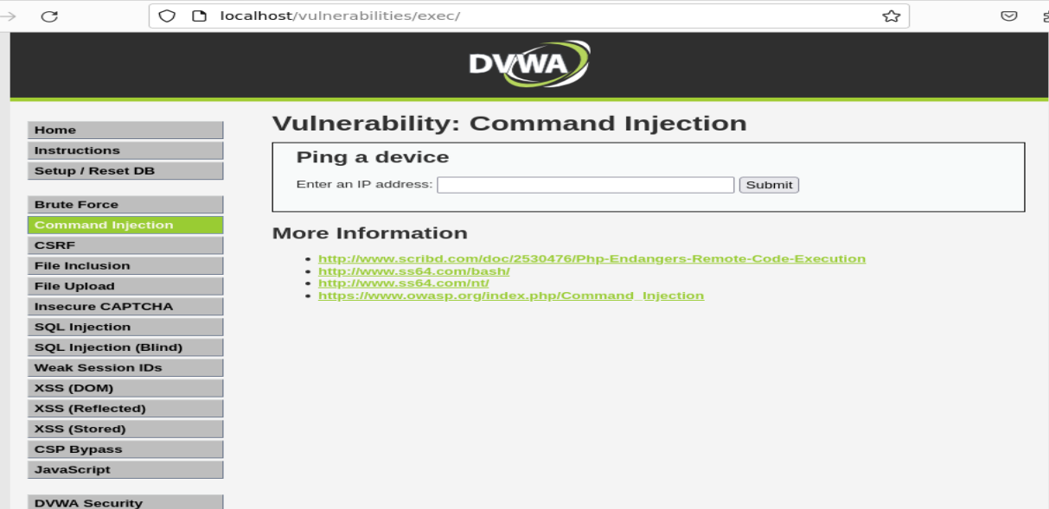
Command Injection
Demo

Slide 35
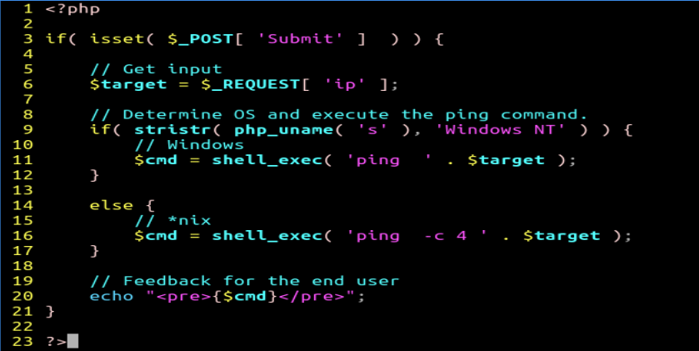
Command Injection
How does command injection occur?

Slide 36

Command Injection
Line 3
if (condition) is a statement; isset() is a function; $_POST is a variable; ‘Submit’ is a key

Slide 37
Command Injection
Line 3
1, $_POST [ ‘Submit‘ ] returns the value of the ‘Submit’ key;
2, if the returned value from step 1 exists, isset($_POST [ ‘Submit‘ ]) returns true, or false otherwise.
3, if the returned value from step 2 is true, for if ( isset($_POST [ ‘Submit‘ ]) ), the web application executes code inside its body.

Slide 38

Command Injection
Line 6
$target: a variable
$_REQUEST[ ‘ip’ ] returns the value of the ‘ip’ key, which is the input from the ‘Enter an IP address’ from the web page.

Slide 39
Command Injection
What does $target equal to? The value from $_REQUEST[ ‘ip’ ]
$_REQUEST[ ‘ip’ ] returns the value of the ‘ip’ key, which is the input from the ‘Enter an IP address’ from the web page.

Slide 40

Command Injection
Line 16 is vulnerable
$cmd is a variable; shell_exec(command) is a function; ‘ping –c 4’ is a shell command; The dot (‘.’) is an operator; $target is a variable.

Slide 41
Command Injection
Line 16 is vulnerable
shell_exec(command) takes a command as a string input and returns an output generated by the command as a string.
‘.’ concatenates two strings together.

Slide 42
Command Injection
Line 16 is vulnerable
‘.’ concatenates two strings together.
When $target equals to ‘127.0.0,1 ; cat /etc/passwd’
The whole command for shell_exec becomes a string as below:
’ping –c 4 127.0.0,1 ; cat /etc/passwd’
The command will be executed by executing the ping and cat commands and its output will be assigned to $cmd.

Slide 43
Command Injection
Line 16 is vulnerable
Root cause of command injection: ‘$target’ is a variable and its value is decided by user inputs. The value is not sanitized before it is executed by the web application.

Slide 44
Command Injection
How does command injection occur?
How to prevent command injection?
How to detect command injection?

Slide 45
Command Injection
How does command injection occur?
A user injects some malicious shell commands into a web application.
The application implements a vulnerable logic that executes the commands.

Slide 46
Command Injection
How does command injection occur?

Slide 47
Command Injection
How does command injection occur?
How to prevent command injection?
e.g., input sanitisation (removing semicolons); avoiding user shell commands
ping –c 4 127.0.0,1 ; cat /etc/passwd

Slide 48
Command Injection
How does command injection occur?
How to prevent command injection?
e.g., input sanitisation (removing semicolons); avoiding user shell commands
commands
users
pre-defined instructions

Slide 49
Command Injection
How does command injection occur?
How to prevent command injection?
e.g., input sanitisation (removing semicolons); avoiding user shell commands
How to detect command injection?
e.g., detecting unexpected outputs; detecting unusual system activities:
ping –c 4 127.0.0,1 ; cat /etc/passwd

Slide 50
XSS
What is XSS?
XSS allows an attacker to inject malicious scripts into a vulnerable web page that is viewed by other users, e.g., triggering users into opening a phishing website.
XSS types: DOM XSS, Stored XSS, Reflected XSS

Slide 51
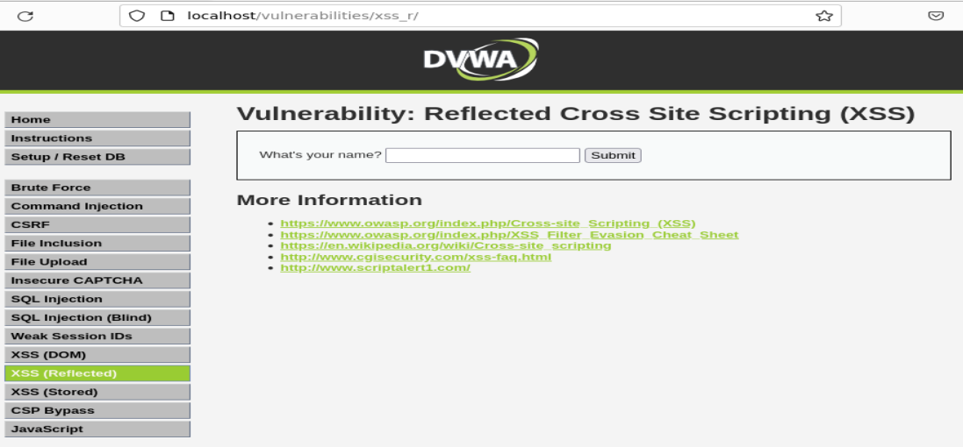
XSS
Demo

Slide 52
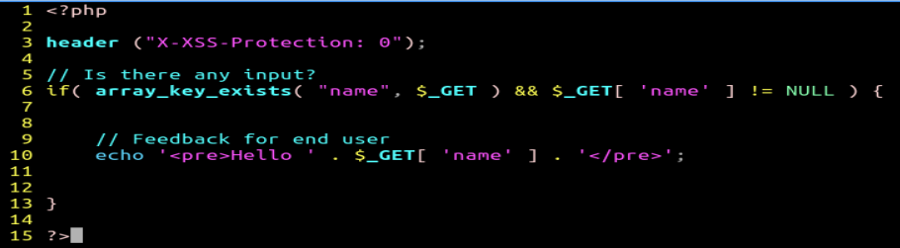
XSS
How does XSS occur?

Slide 53

XSS
Line 3
disabling the XSS protection built into modern browsers.

Slide 54
XSS
Line 6
if () is a statement; array_key_exists () is a function; $_GET is a variable; “name” or ‘name’ is a key; && is logical operator that means AND
Two conditions are concatenated via && for the if statement
array_key_exists(“name”, $_GET) is a condition
$_GET[ ‘name’ ] is the other condition

Slide 55
XSS
Line 6
array_key_exists(“name”, $_GET)
It checks whether the "name" key exists in the $_GET variable. If the key exists, this condition returns true;

Slide 56
XSS
Line 6
array_key_exists(“name”, $_GET)
It checks whether the "name" key exists in the $_GET variable. If the key exists, this condition returns true;
$_GET[ ‘name’ ]
It returns the value of the ‘name’ key. If the value is non-empty, this condition is true;
If both conditions are true, then code in line 10 will be executed.

Slide 57
XSS
Line 10 is vulnerable
echo is a command for printing; $_GET is a variable; ‘name’ is a key; The dot (‘.’) is an operator for concatenation.
<pre> and </pre> are HTML tags which are used to format the text between the tags. E.g.,
<pre>
Alice: Hello Bob!
Bob: Hello Alice!
</pre>

Slide 58
XSS
Line 10 is vulnerable
This echo statement will display hello and the value of the ‘name’ key back to the browser of an end-user.
When $_GET[ ‘name’] equals to:
http://localhost/?name=<script> window.location = "https://uwa.edu.au"; </script>
Code between the scripts will be executed by the browser.

Slide 59
XSS
Line 10 is vulnerable
Root cause of XSS: the value from the ‘name’ key is provided as an input and not sanitized before it is displayed back to the user.

Slide 60
XSS
How does XSS occur?
How to mitigate XSS?

Slide 61
XSS
How does XSS occur?
A malicious user injects malicious scripts into a web application.
The application implements a vulnerable logic that displays the malicious input back to the user.
The browser of the user will execute the scripts.

Slide 62
XSS
How does XSS occur?

Slide 63
XSS
How does XSS occur?
How to mitigate XSS?
e.g., input sanitisation; security headers
http://localhost/?name=<script> window.location = "https://uwa.edu.au"; </script>

Slide 64
XSS
How does XSS occur?
How to mitigate XSS?
e.g., input sanitisation; security headers
disabling the XSS protection built into modern browsers.

